Slide 1


Design Space Exploration for Compressed Deep Convolutional Neural Network on SCALE Sim
Peilin Chen, Xinyuan Fu, Hanyuan Gao, Feilian Dai
6501 Group6
2024/12/05

Slide 2
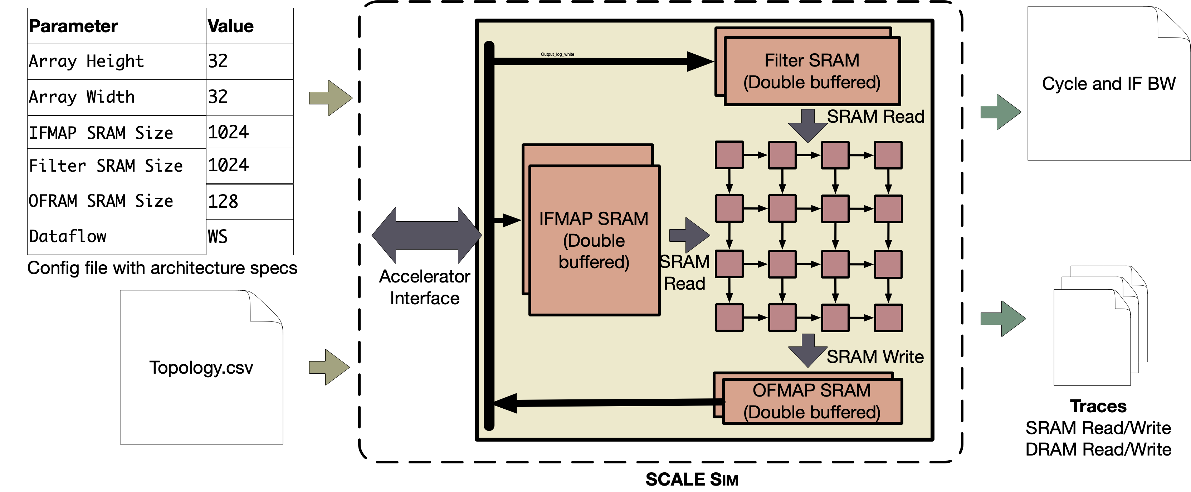
The hardware platform we use
Systolic CNN AcceLErator Simulator (SCALE Sim)
Fig. Overview of SCALE Sim
SCALE Sim takes two files as input from the user: one is the hardware configuration, the other is the neural network topology (workload).
SCALE Sim generates two types of outputs: one is the cycle accurate traces for SRAM and DRAM, the other is the metrics like cycle counts, utilization, bandwidth requirements, total data movement, etc.
https://github.com/scalesim-project/scale-sim-v2?tab=readme-ov-file
Samajdar, Ananda, et al. "A systematic methodology for characterizing scalability of dnn accelerators using scale-sim." 2020 IEEE International Symposium on Performance Analysis of Systems and Software (ISPASS). IEEE, 2020.
2024/12/3
2

Slide 3
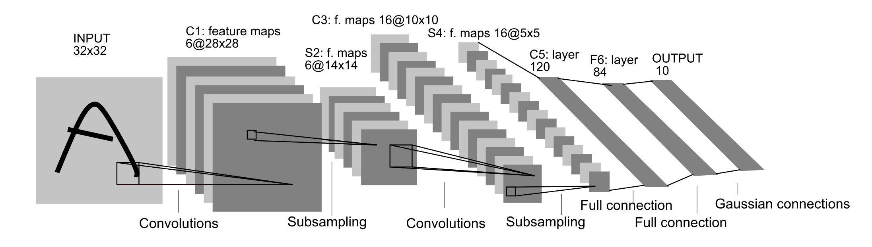
NN Quantization
LeNet-5 <-> Hand-written Digit Recognition
Fig. LeNet-5 Structure.
LeNet-5:
three Convolutional layers, two Pooling layers, two Fully-connected layers.
Parameter size: C1(1×5×5×6+6) + C3(6×5×5×16+16) + C5(5×5×16×120+120) + F6(120×84) + OUTPUT(84×10) = 61,686
2024/12/3
LeCun, Yann, et al. "Gradient-based learning applied to document recognition." Proceedings of the IEEE 86.11 (1998): 2278-2324.
3

Slide 4
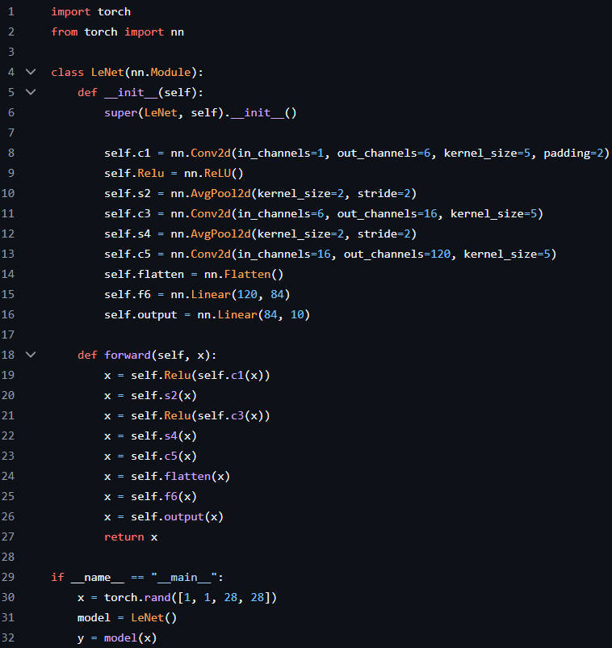
NN Quantization
Model definition
2024/12/3
LeCun, Yann, et al. "Gradient-based learning applied to document recognition." Proceedings of the IEEE 86.11 (1998): 2278-2324.
4

Slide 5
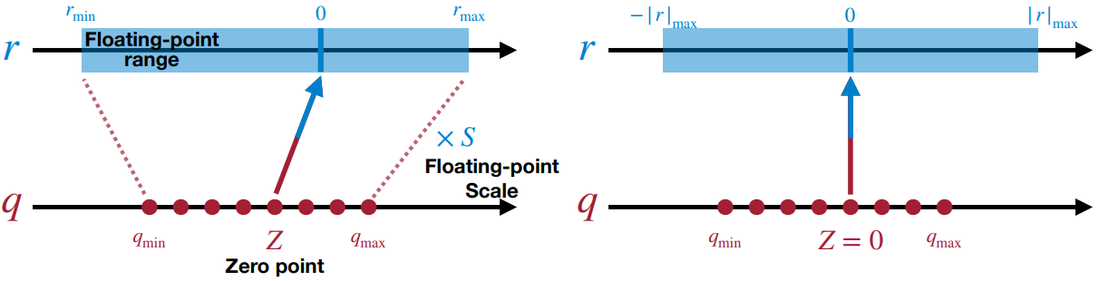
NN Quantization
Linear asymmetric quantization
Linear quantization method:
Symmetric Quantization
Asymmetric Quantization
https://hanlab.mit.edu/courses/2023-fall-65940.
Shortcoming
Asymmetric Quantization: Better than symmetric quantization because … But more complex.
Symmetric Quantization: Simple and easy to be implemented in hardware design. But it has a shortcoming.
This part is useless.
2024/12/3
5

Slide 6
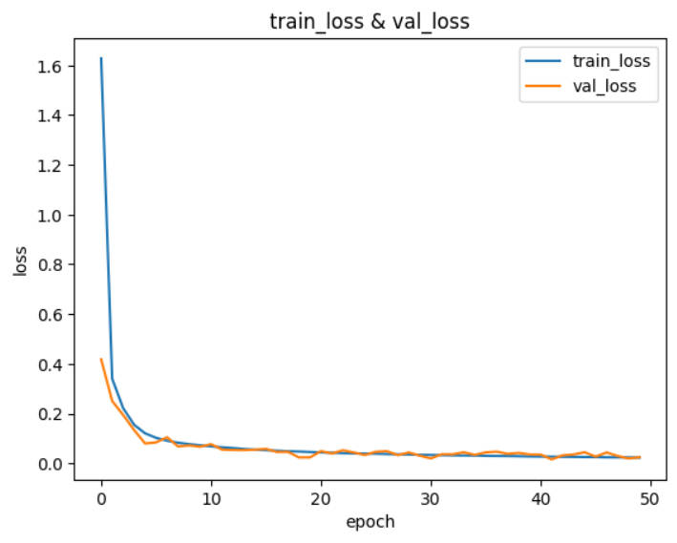
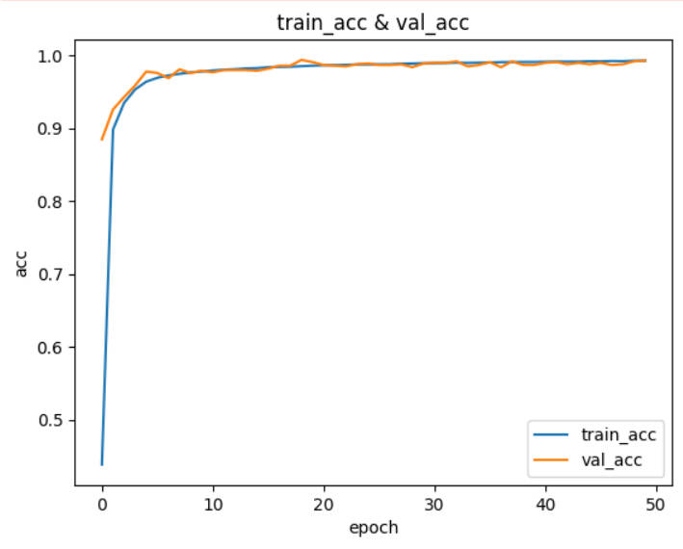
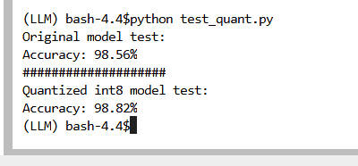
NN Quantization
Training and Quantization results
Fig. Original model vs. Quantized model.
Fig. train_loss & val_loss.
Fig. train_acc & val_acc.
The training and test batch size are 32 and 1000, respectively.
The learning rate and momentum are 0.001 and 0.9, respectively.
Compared to the original LeNet-5 model, the quantized int8 LeNet-5 model achieves no accuracy loss.
2024/12/3
6

Slide 7
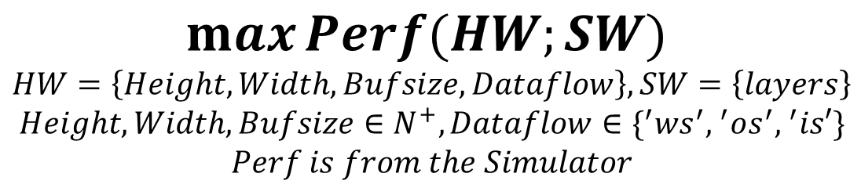
Design Space Exploration
Design Space Exploration
Design Space Exploration
Definition: Given a network, optimize the hardware (Systolic Array) configuration (array size, dataflow)
Object: Performance (Cycles, the sim only provides the perf result)
Variable/Design Space: [Array Height, Array Width, Dataflow Type]
Design Space
（Arraysize, Bufsize, Dataflow）
Hardware
Configuration
Scale-Sim
Perf
Result
Software
Configuration
$$\max{Perf(HW;SW)}$$
$$HW=\left\{Height, Width,Bufsize, Dataflow\right\}, SW=\left\{layers\right\}$$
$$Height, Width,Bufsize∈N^{+}, Dataflow∈\{^{′}w{s^{′}, }^{′}o{s^{′}, }^{′}is′\}$$
$$Perf is from the Simulator$$
2024/12/3
7

Slide 8
Design Space Exploration
Design Space Exploration
For small space
Brute Force Search
For large design space,
the exploration time is huge (hours)
How to make it fast?
Search fast (Genetic, Simulated annealing …).
Estimate fast (A proxy estimator)
Machine Learning
Analytical Model (Timeloop, Maestro)
Design Space
√
Hardware
Configuration
Scale-Sim
Perf
Result
Software
Configuration
SAMPLES
Hardware
Configuration
Proxy Model
√
Software
Configuration
MLP
AI FOR AI HW!
2024/12/3
8

Slide 9
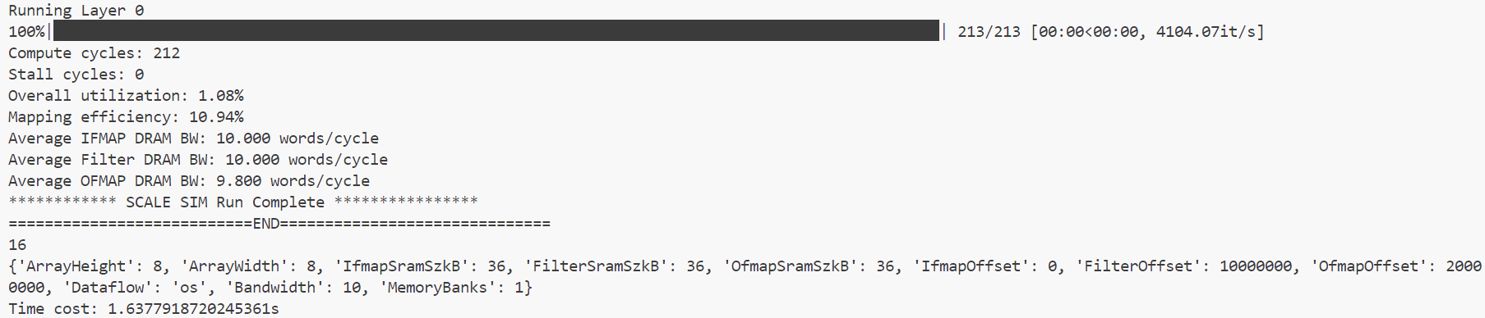
Design Space Exploration Result
Design Space Exploration Result
The accuracy is shown later.
Search (Single Layer Conv, PEs=64) Result
Time Cost Result
Mins to < 1sec.
2024/12/3
9

Slide 10
Proxy model
MLP Network
Why we need a proxy:
Motivation: SIM takes too much time,
Example: 500k design points cost 150+hours;
Why we choose MLP:
The task is a High-dimensional space function fitting task rather than a classification task;
MLP is a smooth model and a good fit for later searching;
MLP has a simple structure and we need a simple structure to prevent overfitting;
Parameters:
Width(systolic array)
Hight(systolic array)
Dataflow type(ws,os,is)
Buffersize
Software(mat mal)
M,N,K(matrix)
Output is a number representing cycles
5 FC Layers MLP Network
.
.
.
.
.
.
.
.
8 features input
output
Layer5
64x1
Layer1
8x128
Layer2
128x256
Layer3
256x128
Layer4
128x64
2024/12/3
10

Slide 11
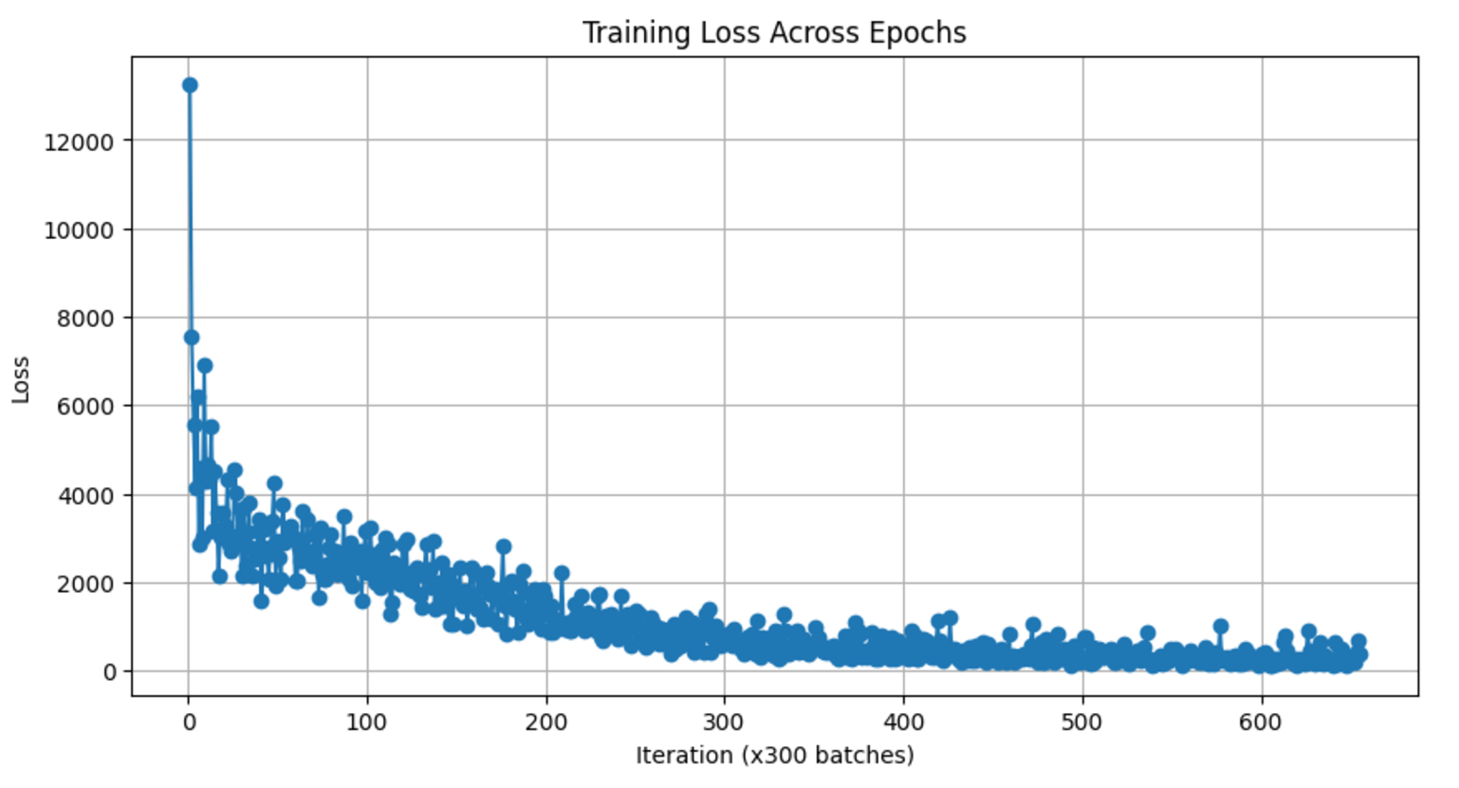
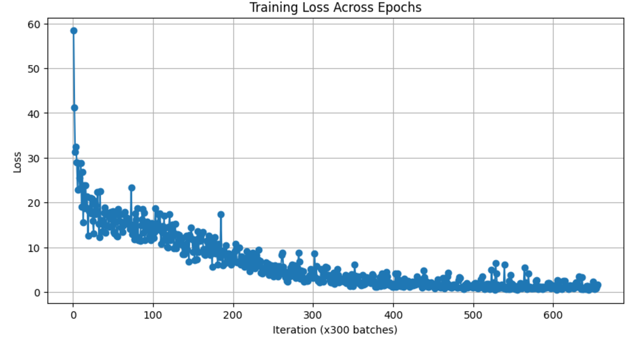
Proxy model result
MLP Network
Our results:
Make batch size 1
Relative error within 1%
$$Prediction Loss={(Output−Target)}^{2}$$
$$Relative Loss={(Output−Target)}^{2}/Target$$
Fig. Prediction loss (MSE)
Fig. Relative prediction loss
2024/12/3
11

Slide 12
Thanks
THANKS

